Slide 1
Data Analytics
Lecture –3
Sumita Narang

Slide 2
Objectives
Defining Analytics
Types of data analytics
Descriptive, Diagnostic
Predictive, Prescriptive
Data Analytics – methodologies
CRISP-DM Methodology
SEMMA
BIG DATA LIFE CYCLE
SMAM
Analytics Capacity Building
Challenges in Data-driven decision making

Slide 3
Data Analytics Methodologies
Data analytics - methodologies
KDD – Knowledge Discovery in Database
(https://www.youtube.com/watch?v=a4M3GdI5UFY
http://www2.cs.uregina.ca/~dbd/cs831/notes/kdd/1_kdd.html)
CRISP-DM Methodology
SEMMA
BIG DATA LIFE CYCLE (https://www.tutorialspoint.com/big_data_analytics/big_data_analytics_lifecycle.htm)
SMAM
ASUM- DM

Slide 4
CRISP-DM https://www.kdnuggets.com/2014/10/crisp-dm-top-methodology-analytics-data-mining-data-science-projects.html https://www.datasciencecentral.com/profiles/blogs/crisp-dm-a-standard-methodology-to-ensure-a-good-outcome SEMMA https://documentation.sas.com/?docsetId=emref&docsetTarget=n061bzurmej4j3n1jnj8bbjjm1a2.htm&docsetVersion=14.3&locale=en http://jesshampton.com/2011/02/16/semma-and-crisp-dm-data-mining-methodologies/ SMAM https://www.kdnuggets.com/2015/08/new-standard-methodology-analytical-models.html KDD http://www2.cs.uregina.ca/~dbd/cs831/notes/kdd/1_kdd.html https://data-flair.training/blogs/data-mining-and-knowledge-discovery/ https://pdfs.semanticscholar.org/7dfe/3bc6035da527deaa72007a27cef94047a7f9.pdf?_ga=2.146116535.226632156.1578656398-640734799.1575775195 Big Data Lifecycle http://www.informit.com/articles/article.aspx?p=2473128&seqNum=11 https://www.linkedin.com/pulse/four-keys-big-data-life-cycle-kurt-cagle/ ASUS-DM https://www.researchgate.net/publication/326307750_Towards_an_Improved_ASUM-DM_Process_Methodology_for_Cross-Disciplinary_Multi-organization_Big_Data_Analytics_Projects_13th_International_Conference_KMO_2018_Zilina_Slovakia_August_6-10_2018_Proceeding

Slide 5
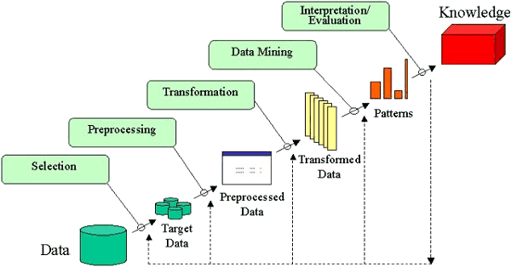
KDD – Knowledge Discovery in Database Process

Slide 6
SEMMA Process
Acronym SEMMA stands for Sample, Explore, Modify, Model, Assess.
Sample —Identify, merge, partition, and sample input data sets, among other tasks.
Explore —explore data sets statistically and graphically. plot the data, obtain descriptive statistics, identify important variables, and perform association analysis, among other tasks.
Modify —prepare the data for analysis. Examples of the tasks that you can complete for these nodes are creating additional variables, transforming existing variables, identifying outliers, replacing missing values, performing cluster analysis, and analyzing data with self-organizing maps (SOMs) or Kohonen networks.
Model —fit a predictive model to a target variable. Available models include decision trees, neural networks, least angle regressions, support vector machines, linear regressions, and logistic regressions.
Assess —compare competing predictive models. They build charts that plot the percentage of respondents, percentage of respondents captures, lift, and profit.

Slide 7
Comparison Study – KDD vs SEMMA
By doing a comparison of the KDD and SEMMA stages we would, on a first approach, affirm that they are equivalent:
Sample can be identified with Selection;
Explore can be identified with Pre processing;
Modify can be identified with Transformation;
Model can be identified with Data Mining;
Assess can be identified with Interpretation/Evaluation. Examining it thoroughly, we may affirm that the five stages of the SEMMA process can be seen as a practical implementation of the five stages of the KDD process, since it is directly linked to the SAS Enterprise Miner software.

Slide 8
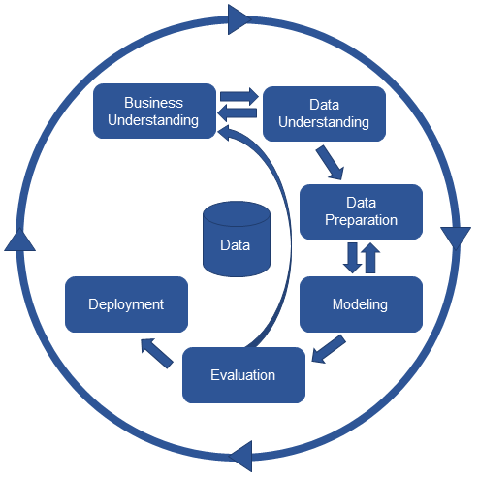
CRISP-DM Process
CRISP-DM stands for CRoss-Industry Standard Process for Data Mining. It consists on a cycle that comprises six stages

Slide 9
Comparison Study – KDD vs CRISP-DM
Comparing the KDD stages with the CRISP-DM stages is not as straightforward as in the SEMMA situation. CRISP-DM methodology incorporates the steps that, as referred above, must precede and follow the KDD process that is to say:
The Business Understanding phase can be identified with the development of an understanding of the application domain, the relevant prior knowledge and the goals of the end-user;
The Deployment phase can be identified with the consolidation by incorporating this knowledge into the system.
The Data Understanding phase can be identified as the combination of Selection and Pre processing;
The Data Preparation phase can be identified with Transformation;
The Modeling phase can be identified with Data Mining;
The Evaluation phase can be identified with Interpretation/Evaluation.

Slide 10
KDD vs SEMMA vs CRISP-DM

Slide 11
Drawbacks of CRISP-DM 1/
One major drawback is that the model no longer seems to be actively maintained. The official site, CRISP-DM.org, is no longer being maintained. Furthermore, the framework itself has not been updated on issues on working with new technologies, such as big data.
Big data technologies means that there can be additional effort spend in the data understanding phase, for example, as the business grapples with the additional complexities that are involved in the shape of big data sources.
CRISP-DM is a great framework and its use on projects helps focus them on delivering real business value. CRISP-DM has been around a long time so many projects that are using CRISP-DM are taking shortcuts. Some of these shortcuts make sense but too often they result in projects using a corrupted version of the approach like the one shown in Figure .

Slide 12
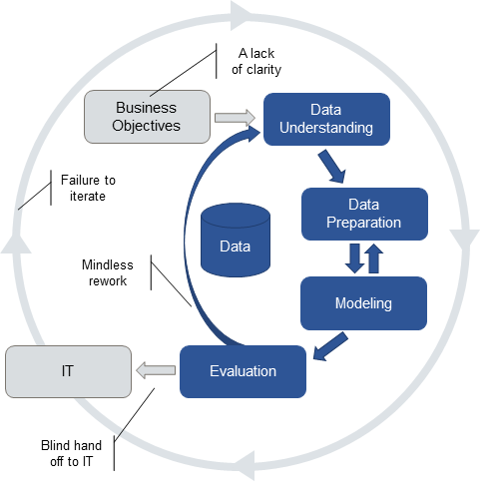
Drawbacks of CRISP-DM 2/
A lack of clarity: Rather than drill down into the details and really get clarity on both the business problem and exactly how an analytic might help, the project team make do with the business goals and some metrics to measure success.
Mindless rework: Most try to find new data or new modeling techniques rather than working with their business partners to re-evaluate the business problem.
Blind hand-off to IT: Some analytic teams don’t think about deployment and operationalization of their models at all. Fail to recognize that the models they build will have to be applied to live data in operational data stores or embedded in operational systems.
Failure to iterate Analytic professionals know that models age and that models need to be kept up to date if they are to continue to be valuable.

Slide 13
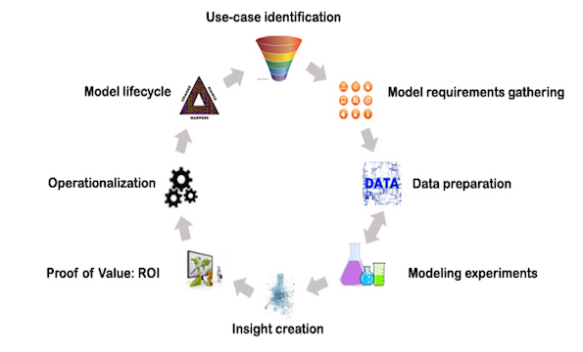
Standard Methodology for Analytical Models (SMAM)
https://www.kdnuggets.com/2015/08/new-standard-methodology-analytical-models.html

Slide 14
SMAM / 2
Phase | Description
Use-case identification | Selection of the ideal approach from a list of candidates
Model Requirements gathering | Understanding the conditions required for the model to function
Data preparation | Getting the data ready for the modeling
Modeling experiments | Scientific experimentation to solve the business question
Insight creation | Visualization and dash-boarding to provide insight
Proof of Value: ROI | Running the model in a small scale setting to prove the value
Operationalization | Embedding the analytical model in operational systems
Model lifecycle | Governance around model lifetime and refresh

Slide 15
Big Data Analytics
Big Data analytics platforms are designed to serve following needs of today’s businesses.
Massive amounts of data - It is big – typically in terabytes or even petabytes
Varied data such as video files to sql databases to text data - It is varied – it could be a traditional database, it could be video data, log data, text data or even voice data
Data that comes in at varying frequency – from days to minutes - It keeps increasing as new data keeps flowing in

Slide 16
Big Data Technologies
MapReduce To understand the beginning of Big Data technology, we will need to go back to 2004 when 2 Googlers – Sanjay Ghemawat and Jeffrey Dean wrote a paper that described how Google used the ‘Divide and Conquer’ approach to deal with its gigantic databases. This approach involves breaking a task into smaller sub-tasks and then working on sub-tasks in parallel, and results in huge efficiencies. Open source software enthusiast ‘Doug Cutting’ was one of the guys deeply inspired by the Google paper. He was able to scale his engine to process a couple of hundred million web pages but the requirement was for something 10,000 times faster than this. This is the computing power Google generates when it processes the trillions of webpages in existence.
Hadoop : Doug and his partner went about creating an Open source file system and processing framework that later came to be known as Hadoop. This formed the basis of their search engine “Nutch”. While the original Google file system was based on C++, Doug’s hadoop was based on Java.

Slide 17
Big Data Technologies contd..
Pig: As hadoop began to be implemented on a larger scale, Big Data specialists soon realized that they were wasting far too much time on writing MapReduce queries rather than actually analyzing data. MapReduce was long and time consuming to write. Developers at Yahoo soon came out with a work around – Pig. Pig is essentially an easier way to write MapReduce queries. It is similar to Python and allows for shorter and more efficient code to be written that can then be translated to MapReduce before execution.
Hive: While this solved the problem for a number of people, there were many who still found this difficult to learn. SQL is a language that most developers are familiar with and hence people at Facebook decided to create Hive – an alternative to Pig. Hive enables code to be written in Hive query language or HQL that, as the name suggests, is very similar to SQL. Thus, we now have an option – if we are familiar with Python, we can pick up Pig to write code. If we have knowledge of SQL, we can go for Hive. In either case, we get away from the time consuming job of writing MapReduce queries.So far we have understood 4 of the most popular Big Data technologies – MapReduce, Hadoop, Pig and Hive.

Slide 18
Big Data Technologies contd..
NoSQL: NoSQL refers to databases that do not follow the traditional tabular structure. This means that the data is not organized in the traditional rows and columns structure. An example of such data is the text from social media sites which can be analyzed to reveal trends and preferences. Another example is video data or sensor data. There are a number of NoSQL database technologies that work well for specific data problems. Hbase, CouchDB, MongoDB and Cassandra are some examples of NoSQL databases. Database technologies enable efficient storage and processing of data. however, in order to analyze this data, Big Data specialists require other specializd technologies.
Mahout /Impala - Mahout is a collection of algorithms that enable machine learning to be performed on hadoop databases. If you were looking to perform clustering, classification or collaborative filtering on your data, Mahout will help you do that. E-commerce companies and retailers have a frequent need to perform tasks like clustering and collaborative filtering on their data and Mahout is a great choice for this. Impala is another technology that enables analytics on Big Data. Impala is a query engine that allows Big Data specialists to perform analytics on data stored on hadoop via SQL or other BI tools. Impala as been developed and promoted by cloudera.

Slide 19
Big Data Life Cycle 1/
A big data analytics cycle can be described by the following stage −
Business Problem Definition – CRISP DM : Business understanding
Research -- new step
Human Resources Assessment – new step
Data Acquisition – new step
Data Munging – new step
Data Storage – new step
Exploratory Data Analysis – CRISP DM : Data Understanding
Data Preparation for Modeling and Assessment – CRISP DM : Data Preparation
Modeling – CRISP DM : Data Modelling
Implementation – CRISP DM : Evaluation & Deployment

Slide 20
Big Data Life Cycle 2/
Research: Analyze what other companies have done in the same situation. This involves looking for solutions that are reasonable for your company, even though it involves adapting other solutions to the resources and requirements that your company has. In this stage, a methodology for the future stages should be defined.
Human Resources Assessment: Once the problem is defined, it’s reasonable to continue analyzing if the current staff is able to complete the project successfully. Traditional BI teams might not be capable to deliver an optimal solution to all the stages, so it should be considered before starting the project if there is a need to outsource a part of the project or hire more people.
Data Acquisition: This section is key in a big data life cycle; it defines which type of profiles would be needed to deliver the resultant data product. Data gathering is a non-trivial step of the process; it normally involves gathering unstructured data from different sources. To give an example, it could involve writing a crawler to retrieve reviews from a website. This involves dealing with text, perhaps in different languages normally requiring a significant amount of time to be completed.
Data Munging: Once the data is retrieved, for example, from the web, it needs to be stored in an easy to-use format. To continue with the reviews examples, let’s assume the data is retrieved from different sites where each has a different display of the data. Suppose one data source gives reviews in terms of rating in stars, therefore it is possible to read this as a mapping for the response variable y ∈ {1, 2, 3, 4, 5}. Another data source gives reviews using two arrows system, one for up voting and the other for down voting. This would imply a response variable of the form y ∈ {positive, negative}.
In order to combine both the data sources, a decision has to be made in order to make these two response representations equivalent. This can involve converting the first data source response representation to the second form, considering one star as negative and five stars as positive. This process often requires a large time allocation to be delivered with good quality.

Slide 21
Big Data Life Cycle 3/
Data Storage: Once the data is processed, it sometimes needs to be stored in a database. Big data technologies offer plenty of alternatives regarding this point. The most common alternative is using the Hadoop File System for storage that provides users a limited version of SQL, known as HIVE Query Language. This allows most analytics task to be done in similar ways as would be done in traditional BI data warehouses, from the user perspective. Other storage options to be considered are MongoDB, Redis, and SPARK.
This stage of the cycle is related to the human resources knowledge in terms of their abilities to implement different architectures. Modified versions of traditional data warehouses are still being used in large scale applications. For example, teradata and IBM offer SQL databases that can handle terabytes of data; open source solutions such as postgreSQL and MySQL are still being used for large scale applications.
Even though there are differences in how the different storages work in the background, from the client side, most solutions provide a SQL API. Hence having a good understanding of SQL is still a key skill to have for big data analytics.
This stage a priori seems to be the most important topic, in practice, this is not true. It is not even an essential stage. It is possible to implement a big data solution that would be working with real-time data, so in this case, we only need to gather data to develop the model and then implement it in real time. So there would not be a need to formally store the data at all.

Slide 22
ASUM-DM
ftp://ftp.software.ibm.com/software/data/sw-library/services/ASUM.pdf
Analytics Solutions Unified Method - Implementations with Agile principles
The Analytics Solutions Unified Method (ASUM) is a step-by-step guide to conducting a complete implementation lifecycle for IBM Analytics solutions.
ASUM is designed to create successful and repeatable IBM Analytics deployments. The method can be utilized by IBM clients and business partners to successfully implement IBM Analytics solutions.

Slide 23
ASUM
ASUM is a methodology to implement AGILE in the project management way of working. So think of ASUM being applied in some phases of CRISP-DM or SNAM i.e. Data Preparation and Modelling.

Slide 24
ASUM

Slide 25
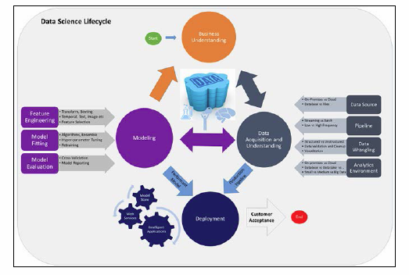
Some More Variations - TDSP
Microsoft Team Data Science Process
The TDSP process model provides a dynamic framework to machine learning solutions that have been through a robust process of planning, producing, constructing, testing, and deploying models. Here is an example of the TDSP process:
https://hub.packtpub.com/two-popular-data-analytics-methodologies-every-data-professional-should-know-tdsp-crisp-dm/

Slide 26
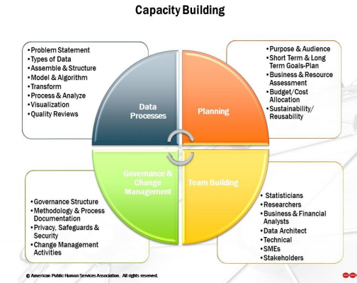
Analytics Capacity Building
Reference – Example : https://chhsdata.github.io/dataplaybook/documents/APHSA-Roadmap-to-Capacity-Building-in-Analytics-White-Paper.pdf

Slide 27
Data driven decision making
Definition – When it is data and not instincts that drives the business decisions.
Examples – Fraud detection in Loans, Credit Cards (Cibil scores); Insurance, Six sigma projects to improve efficiency; Target advertising in e-commerce; Product Roadmap planning, Team planning
6 Steps to Data Driven decision making-
Strategy – Define clear Business goals
Identifying key data focus areas – Data is everywhere, flowing from multiple sources. Based on domain knowledge define key focus data sources which seem to impact the most, easier to access, reliable and clean
Data Collection & Storage – Defining data architecture to collect, store, archive i.e. manage data. Connect multiple data sources, clean, prepare and organize
Data Analytics – Analyzing the data and derive key insights
Turning insights to Actions – business actions to be taken based on the findings from key insights from data
Operationalize and Deploy – Using IT systems, automate the data collection, storage, analysis and presenting the key highlights

Slide 28
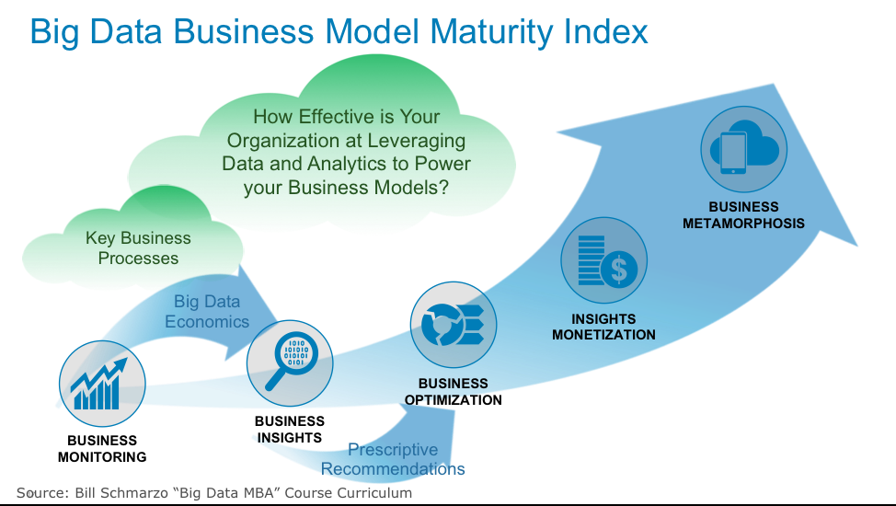
Data Business Model

Slide 29
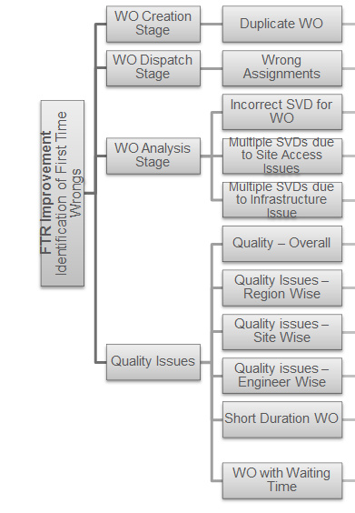
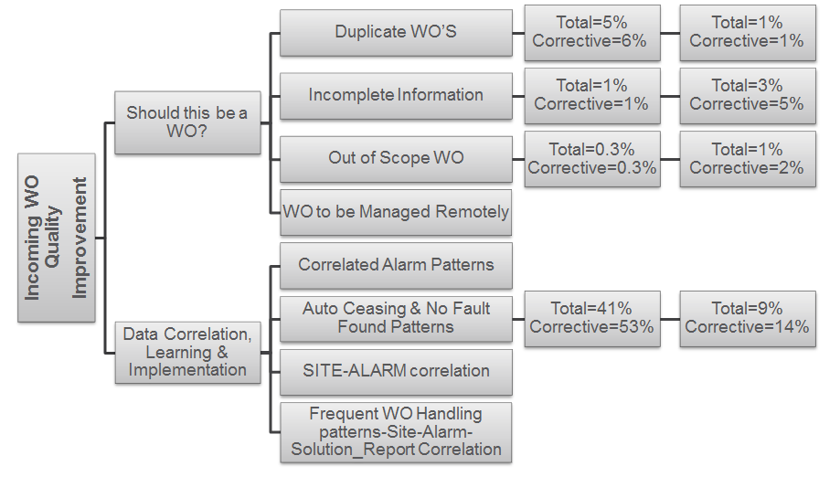
Industry Example – FSO Analytics Tool
Business Objective fro FSO Department: Target for 5 top clients in India, Europe, South Africa and Costa Rica Markets
FTR (Frist Time Right) Improvement by 2%
Improve incoming WO Quality by 5%

Slide 30
References
https://www.scnsoft.com/blog/4-types-of-data-analytics
https://pdfs.semanticscholar.org/7dfe/3bc6035da527deaa72007a27cef94047a7f9.pdf
https://www.nap.edu/read/23670/chapter/6#57
https://www.kdnuggets.com/2017/01/four-problems-crisp-dm-fix.html
https://www.jigsawacademy.com/em/Beginners_Guide_to_Analytics.pdf
https://data-flair.training/blogs/data-analytics-tutorial/

Slide 31
Challenges/ Concerns
Identifying the problem
One of the major steps in analyzing a problem and designing a solution is to first figure out the problem properly and define each aspect of it. Many times Data scientists opt for a mechanical approach and start working on data sets and tools without a clear definition of the business problem or the client requirement.
Access to right data – Data quantity
For right analysis, it is very important to lay the hands on the right kind of data. Gaining access to a variety of data in the most appropriate format is quite difficult as well as time-consuming. There could be issues ranging from hidden data, insufficient volume of data or less variety in the kind of data. Data could be spread unevenly across various lines of business so getting permission to access that data can also pose a challenge.
Data Cleansing – Data quality
According to a study by MIT, Big Data has begun to cost companies up to 25% of possible revenue because cleansing bad data is eroding operating expenses.
Lack of domain expertise
Data Scientists also need to have sound domain knowledge and gain subject matter expertise. One of the biggest challenges faced by data scientists is to apply domain knowledge to business solutions. Data scientists are a bridge between the IT department and the top management.
Data security issues
Since data is extracted through a lot of interconnected channels, social media as well as other nodes, there is increased vulnerability of hacker attacks. Due to the confidentiality element of data, Data scientists are facing obstacles in data extraction, usage, building models or algorithms. The process of obtaining consent from users is causing a major delay in turnaround time and cost overruns.
https://www.eaie.org/blog/7-challenges-becoming-data-driven.html#:~:text=Data%20can%20play%20an%20important,and%20wrong%20or%20missing%20information.

